Slide 1

BANK CUSTOMER CHURN PREDICTION GROUP PROJECT BIG DATA ANALYTICS (IST 718)
COLLIN TAYLOR
EMINE KAKILLIOGLU
HENDI KUSHTA
MK SOWMEYA

Slide 2

OBJECTIVE
The objective of our project is to apply Spark to solve a business problem by developing a predictive model for bank customer churn. We aim to use a dataset containing information about bank customers to identify factors contributing to churn and build a predictive model that classifies customers as potential churners or not.
Link: https://www.kaggle.com/datasets/shantanudhakadd/bank-customer-churn-prediction
CreditScore (int64)
Geography (object)
Gender (object)
Age (int64)
Tenure (int64)
Exited (int64)
Balance (float64)
NumOfProducts (int64)
HasCrCard (int64)
IsActiveMember (int64)
EstimatedSalary (float64)

Slide 3
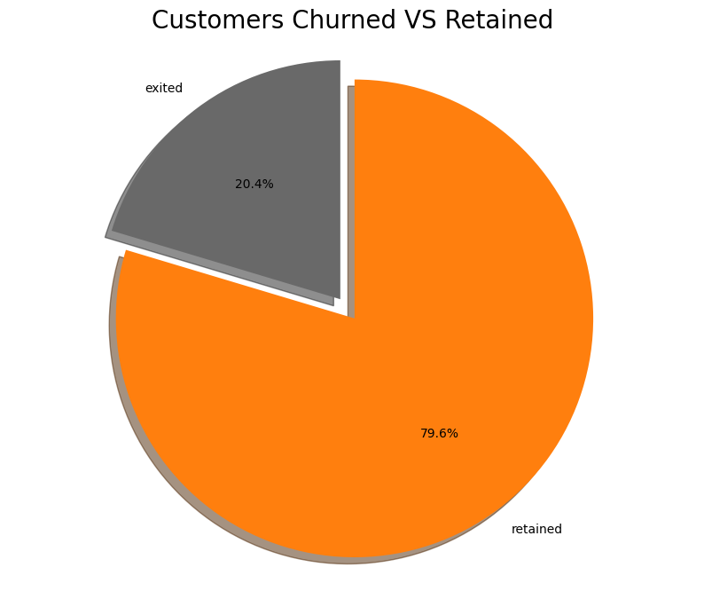
DATA EXPLORATION
The proportion of customers who have churned (Exited) versus those who have been retained. Roughly 80% of the customers retained and 20% of the customers exited.

Slide 4
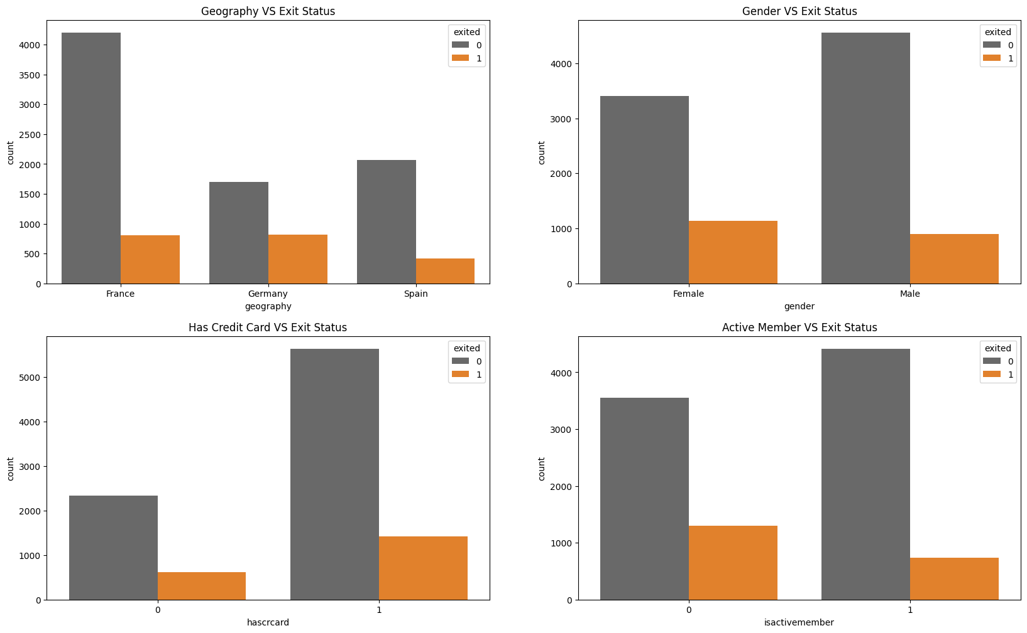
DATA EXPLORATION
Comparing exit status and factors such as geography, gender, possession of a credit card, and active membership.

Slide 5
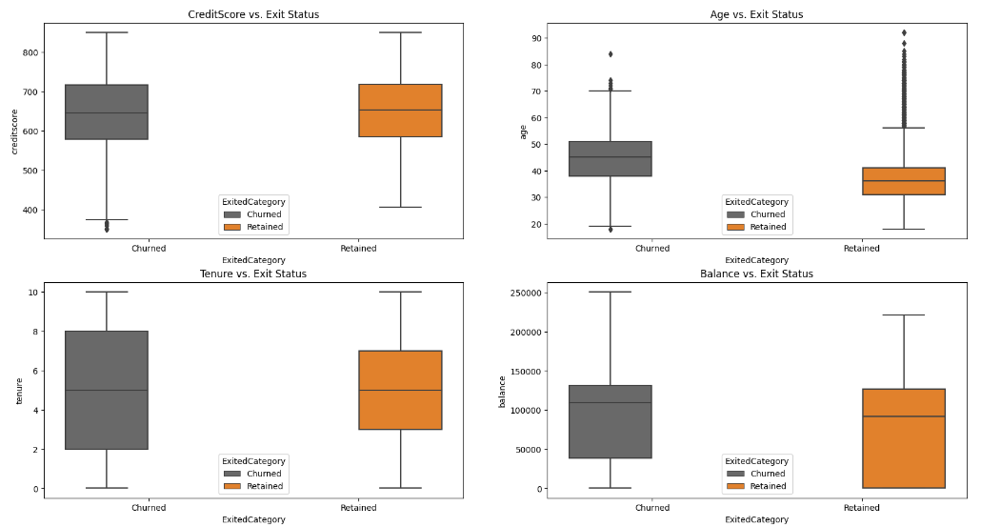
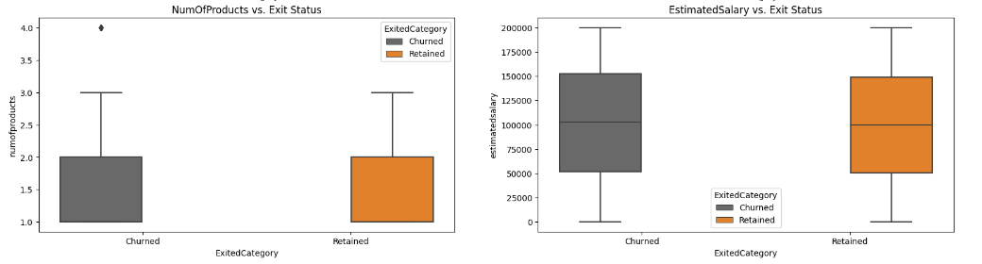
DATA EXPLORATION
Comparing exit status and factors such credit scores, age, tenure, balance of a credit card, number of products, and estimated salary of the customer.

Slide 6
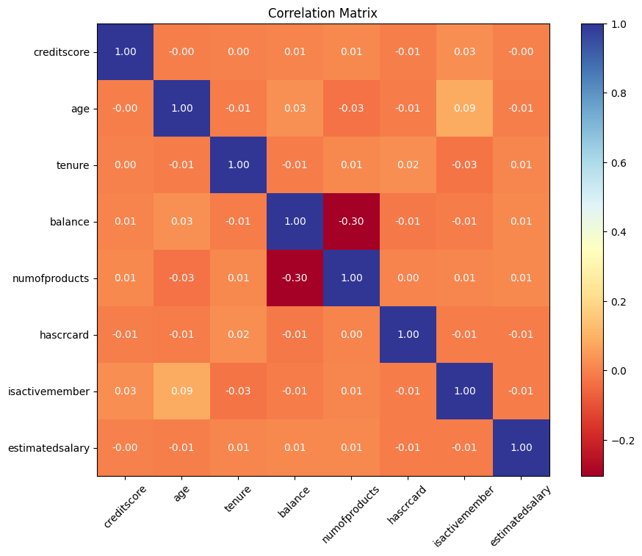
DATA EXPLORATION
Correlation matrix of the Variables.

Slide 7

DATA PREPARATION
Dropped Customer id and row number id columns
One hot Encoding for categorical attributes (geography and gender)

Slide 8

MACHINE LEARNING ALGORITHMS
In addressing the critical nature of our problem, we'll check different machine learning algorithms for optimal performance, comparing their accuracy and ROC AUC (Receiver Operating Characteristic Area Under the Curve) metrics.
We compared Accuracy and ROC AUC metrics because accuracy gives an overall performance indication, while ROC AUC provides insights into a model's discriminatory power, particularly in scenarios with imbalanced classes. Both metrics together offer a more thorough understanding of a classification model's strengths and weaknesses.
Since our task involves classification, the selected algorithms for consideration are:
K-Nearest Neighbor (KNN)
Logistic Regression (LR)
Gradient Boosting (GB)
RandomForest (RF)

Slide 9
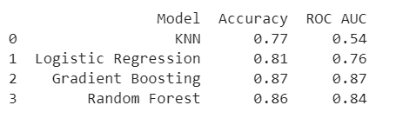
SIMPLE MODELS
Based on the accuracy and ROC AUC metrics, the Gradient Boosting and Random Forest models appear to be the most effective for this classification task.

Slide 10
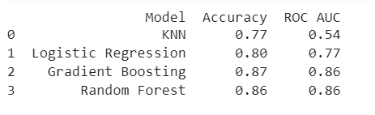
CROSS VALIDATION & HYPERPARAMETER TUNING
Evaluate a model’s generalization performance on different subsets of the training data.
K-Nearest Neighbors (KNN):
Parameter Grid: n_neighbors: [3,5,7]
Cross-Validation Technique: GridSearchCV with 5-fold cross-validation and ROC AUC scoring
Logistic Regression:
Parameter Grid: regParam: [0.01, 0.1, 1.0], elasticNetParam: [0.0, 0.5, 1.0]
Cross-Validation Technique: ParamGridBuilder with 5-fold CrossValidator and ROC AUC scoring
Gradient Boosting:
Parameter Grid: maxDepth: [3,5,7], maxlter: [10,20,30]
Cross-Validation Technique: ParamGridBuilder with 5-fold CrossValidator and ROC AUC scoring
Random Forest:
Parameter Grid: numTrees: [10,20,30], maxDepth: [3,5,7]
Cross-Validation Technique: ParamGridBuilder with 5-fold CrossValidator and ROC AUC scoring
-0.01
0.80
0.77
-0.01
0.86
+0.01
0.86
+0.02

Slide 11
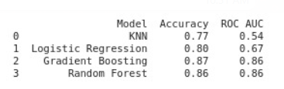
CROSS VALIDATION & HYPERPARAMETER TUNING
Hyperparameter tuning resulted in a decrease in ROC AUC for Logistic Regression. Despite this slight adjustment in the metrics, the outcome of hyperparameter tuning highlights that both Gradient Boosting and Random Forest models consistently outperform others in terms of accuracy and ROC AUC for chunk prediction.
-0.01
0.80
0.67
-0.09
0.86
-0.01
0.86
+0.02

Slide 12
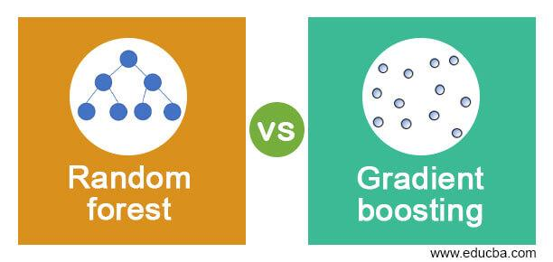
CONCLUSION
In conclusion, the comprehensive assessment reveals that both Gradient Boosting and Random Forest models consistently outshine others in accuracy and ROC AUC metrics for our churn classification task.

Slide 13
FUTURE WORK
Compare the results with other algorithms.
Try to find a larger dataset, with a better target value distribution.
Do more testing with different features.

Slide 14
THANK YOU!

